Slide 1
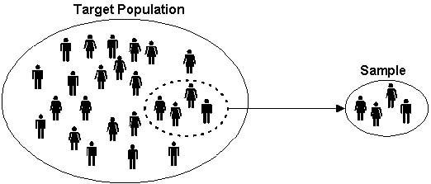
Sampling Methods
By: Hossein

Slide 2
Want to know about:
Average age of UWO students (2016)
Average annual income of Canadians in 2016
Average height of all Canadian students (2016)

Slide 3
Definitions:
Population: a collection of all subjects that are being studied.
Sample: a subset or a group of subjects selected from the population
Sampling strategy: is a technique used in selecting samples from population for research.
PARAMETER
(Population)
STATISTIC
(Sample)

Slide 4
What is a sample?
A sample is a subset of your population by which you select to be participants in your study.
What is sampling?
Sampling is simply stated as selecting a portion of the population, in your research area, which will be a representation of the whole population.
What are sampling strategies?
The strategy is the plan you set forth to be sure that the sample you use in your research study represents the population from which you drew your sample.

Slide 5
Probability sampling:
  includes some form of random selection in choosing the elements. This type of sampling involves a selection process in which each element in the population has an equal and independent chance of being selected.
Non-probability sampling:
  the elements that make up the sample, are selected by nonrandom methods. This type of sampling is less likely than probability sampling.

Slide 6
Probability sampling Techniques:
Simple random sampling
Stratified random sampling
Cluster sampling
Systematic sampling

Slide 7
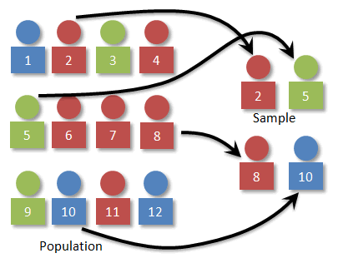
Simple random sampling
Each unit has equal chance of being included in the sample
Taking a sample of size n (n units) randomly
Average age of UWO students (2016)

Slide 8
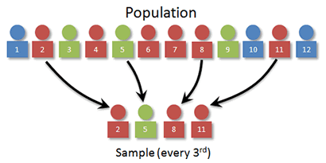
Systematic sampling
Order all units of population (label them)
selection of samples is according to some regular rule, plan or system.
Just the first unit is selected randomly
Average age of UWO students (2016)

Slide 9
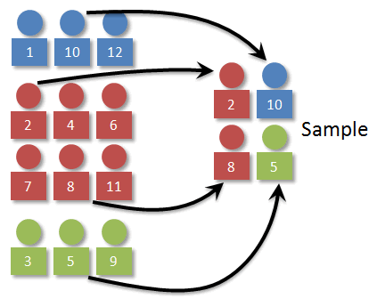
Stratified random sampling
Divide the population into some groups
Choose a sampling technique suitable for making samples from each group separately
Proportion of groups
Average age of UWO students (2016)

Slide 10
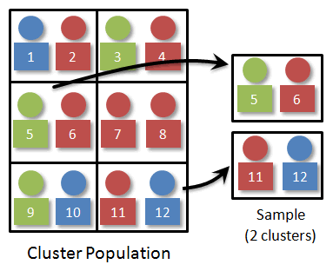
Cluster sampling
Whole population is divided into groups or clusters.
Next, the samples are chosen at random from the clusters
Average age of UWO students (2016)

Slide 11
Cluster Sampling vs Stratified Sampling
vs.
in stratified sampling, random sampling technique is applied to the elements of each group
in cluster sampling, random sampling method is applied to clusters choosing them as units.

Slide 12
Non Probability sampling:
Convenience Sampling
Consecutive Sampling
Quota Sampling
Judgmental Sampling
Snowball Sampling

Slide 13
Thanks!

